Slide 1
CSE 2102: Introduction to Software Engineering
Introduction and Motivation
Need for Software Engineering

Slide 2
What is a program ?
A plan or a routine for solving a problem on a computer.
A sequence of instructions used by a computer to do a particular
job or to solve a given problem.
A set of statements or instructions to be used directly or indirectly
in a computer in order to bring about a certain result.

Slide 3
Program as an interface
P
R
0
G
R
A
M
Problem
Domain
Solution
Domain
Program serves as the interface between the problem
domain and the solution domain.
It is a sequence of instructions to a computer.

Slide 4
Evolution of the Software Business
First software company was established in 1955:
  Computer Usage Company (CUC).
  World’s first independent software company.
  Started with $40,000 in capital.
  Formed by Sheldon and Kubie from IBM.
State of the software business today:
  Contributed $836 billion to GDP.
  Annual growth rate exceeded 7.7%, even when the U.S. economy increased at a very small rate.
  Employs ~ 12.1 million people
  Annual productivity increase of 13.4% from 2020-2027.

Slide 5
Role of Software – How has it Changed?
Software is an important component of several systems and the demand in diverse domains continues to grow:
  Power trains of GM cars contain 30 lines of code (LOC)
  Electric razors contain 2 KLOC
  TV sets contain 500 KLOC.
  Space shuttles and military aircraft - thousands of KLOC.
Demand for larger software systems grows exponentially:
  F4 had no digital computer and software (Early 70’s).
  F16A had 50 digital processors and 135 KLOC (Late 70’s).
  F16D had 300 digital processors and 236 KLOC (Late 80’s).
  B-2 has over 200 digital processors and 5000 KLOC.
  F-35 from Lockheed Martin – over 8 million LOC
Software visible to general public of all ages.

Slide 6
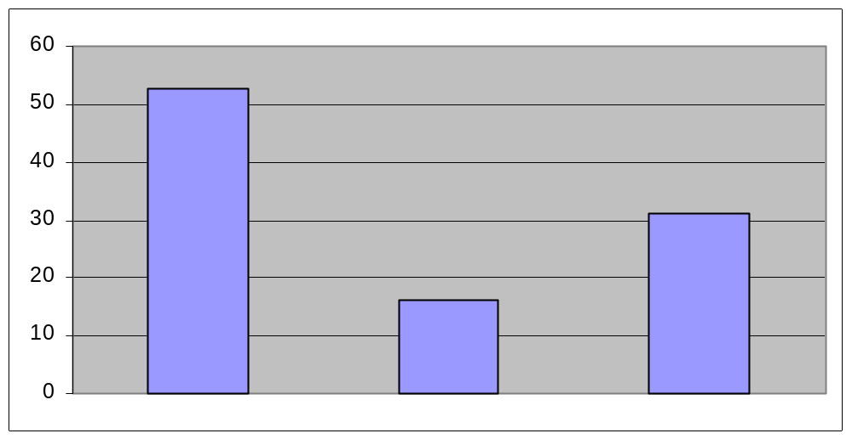
State of the Practice
Cost overrun
Successful
Cancelled
The Standish Group, 2009
Successful projects (32%)
- Delivered fully functional on time and on budget.
Challenged (44%)
- Deliver less than full functionality, over-budget and late.
Failed (24%)
- Cancelled during development.

Slide 7
Software Development Problems
Software costs are increasing as hardware costs continue to decline.
Hardware costs vs. Software costs
Hardware technology has made
great advances.
Simple and well understood tasks
are encoded in hardware.
Least understood tasks are encoded
in software
Demands expected of software are
growing
Size of the software applications is
also increasing.
Hardware
costs
Software
costs
Time

Slide 8
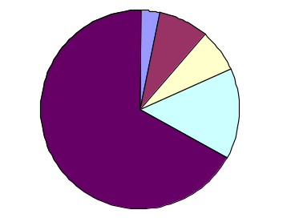
Software Development Problems (contd..)
Software development times are getting longer and longer and
maintenance costs are getting higher and higher
3%
8%
7%
Requirements -- 3%
Design -- 8%
Implementation -- 7%
Testing -- 15%
Maintenance -- 67%
15%
67%
Most of the money and effort spent in testing and maintenance.
85% of errors are introduced during requirements analysis and design.

Slide 9
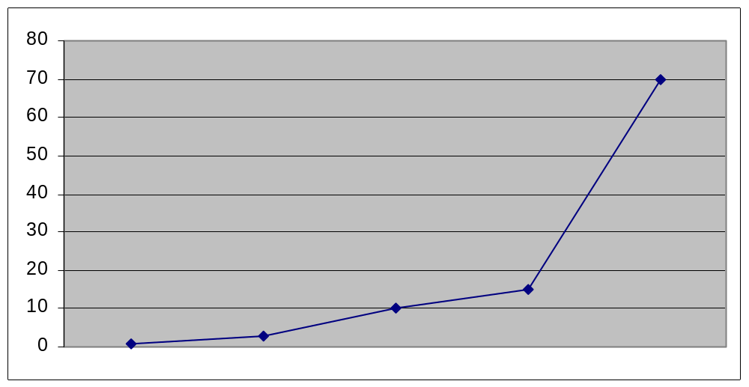
Relative Costs to Fix Errors
Cost to fix an error increases as it is found later and later in
the software lifecycle. Why?
Cost
Design
Testing
Requirements
Implementation
Maintenance

Slide 10
Relative Cost to Fix Errors (contd..)
Why does it cost more to fix errors the later it is found?
  Other work may be built on a ﬂawed foundation, so correcting the original problem may require signiﬁcant rework.
  If the software has already been widely distributed, it might be expensive to get a ﬁx out.
  The developer(s) involved might have forgotten the context surrounding the bug, so it’ll be harder to ﬁx.
  The bug might be located in any existing code, and there’s more to search through as time passes.

Slide 11
Software Development Problems (contd..)
Software errors are getting more and more frequent as hardware
errors become almost non-existent.
Examples of failures attributed to software faults:
  Heathrow Airport Disruption (February 2020).
  Flaws in Medical Infusion Pumps & Ventilators from CareFusion (2015).
  F-35 Joint Strike Fighter jet (detect and lock in on wrong targets) (2018).
  Missile Strike False Alarm in the Hawaii (2018).
  And many other high profile failures..
Software failures cost US economy $1.7 Trillion in financial losses.
Source: 10 Examples of Software Development Failure – ReadWrite
Source: How much could software errors be costing your company? · Raygun Blog

